Slide 1
City of Brentwood
Hazard Mitigation Grant Program
Community Meeting
June 29, 2021

Slide 2
Agenda Overview
Welcome & Introductions
Overview of Hazard Mitigation Grant Program (HMGP)
HMGP Application Process
Results of Benefit-Cost Analysis Screening
Coordination with the Property Owners
Schedule and Next Steps
Closing/Questions

Slide 3
City of Brentwood Staff and Team
Kirk Bednar – City Manager
Todd Petrowski – Planning
Cindy Popplewell – Consultant, Wood E&IS

Slide 4
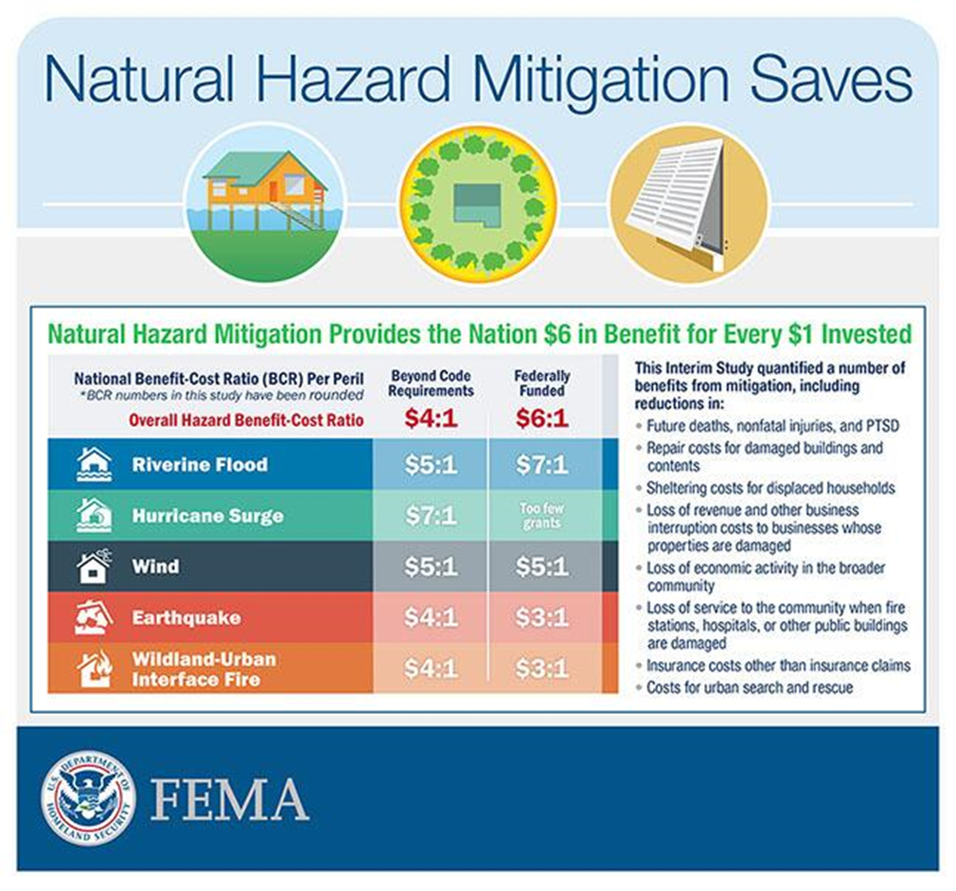
Overview of Hazard Mitigation
Any sustained action taken to reduce or eliminate the long-term risk to people and property from future hazard events
Benefits:
Save lives
Decrease property damage
Losses reduced
Disruptions minimized
Protects critical infrastructure
Financial

Slide 5
Overview of the Hazard Mitigation Grant Program
Authorized under Section 404 of the Robert T. Stafford Disaster Relieve and Emergency Assistance Act
Available funding based upon federal disaster assistance
Contribute 75% of total cost of mitigation measure
Remaining 25% will be split between evenly with State/TEMA and Homeowner
Competitive statewide
Presidential Disaster Declaration 4601-DR-TN – Severe Storms, tornadoes, and flooding March 25 – April 3, 2021
Flooding along Harpeth River Drive, Parker Place, and Williamsburg Road
Provides federal grants to States and local governments for cost-effective projects
FEMA-approved local hazard mitigation plan
Participate in the National Flood Insurance Program (NFIP)
Homeowners cannot apply directly for HMGP funding
Notes:
HMGP Funding is available spent on Public and Individual Assistance for each Presidentially declared disaster

Slide 6
HMGP Application Process
HMGP Project Life Cycle:
Project Scoping:
Identify Problem Area and Mitigation Measure
Eligible activity
Eligible sub-applicant
Conforms to state and local mitigation plans
Cost-effective
Environmentally sound
Solves problem independently
Long-term solution
Beneficial impact to community
Supported by community
Complies with Federal, state, local laws, regulations policies, etc.

Slide 7
HMGP Application Process
HMGP Project Life Cycle:
Project Scoping:
Identify Problem Area and Mitigation Measure
Eligible activity
Eligible sub-applicant
Conforms to state and local mitigation plans
Cost-effective
Environmentally sound
Solves problem independently
Long-term solution
Beneficial impact to community
Supported by community
Complies with Federal, state, local laws, regulations policies, etc.

Slide 8
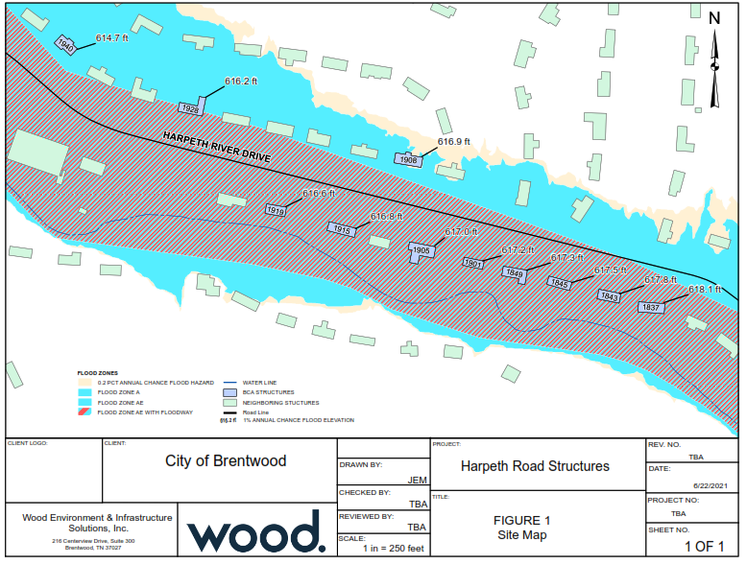

Slide 9
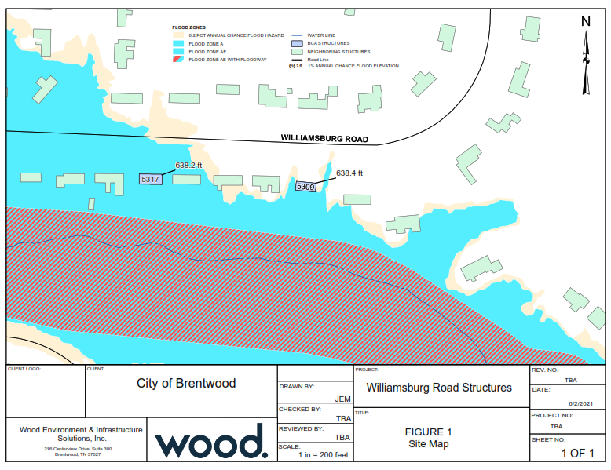

Slide 10
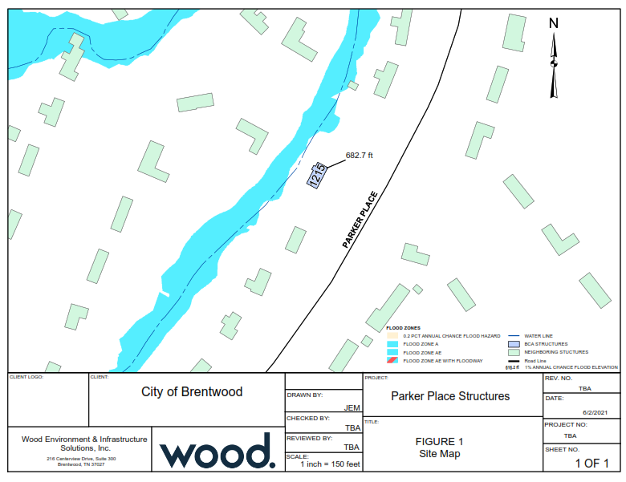

Slide 11
HMGP Application Process
Eligible Activities:
Acquisition/Demolition
Elevation
Structural Relocation
Stormwater Management
Minor Structural Flood Control
Ineligible Activities:
No reduction in risk
Dependent on another project phase to be effective
Construction prior to grant award
Address operation, deferred or future maintenance, repairs, or replacement
Preparedness measures and response equipment
Studies not directly related to design and implementation of proposed project
Structural Retrofitting
Tornado Safe Rooms
Soil Stabilization
Infrastructure Protection
Post-Disaster Code Enforcement
Notes:
Construction costs may not be included as pre-award costs

Slide 12
Benefit-Cost Analysis Screening
Evaluate project benefits in relation to the project costs
A project is cost-effective when the BCR > 1.0
Screen by calculating BCR using lower and upper-bound (worst case) parameters
Low and high estimate of costs
Impact of first floor elevations
Benefits
Costs
Benefit-Cost Ratio (BCR)

Slide 13
Benefit-Cost Analysis Screening
Project Benefits include:
Avoided losses (physical damages) to structures and contents
Avoided displacement cost of residents
Societal benefits
Project Costs include:
Pre/Post Survey – Elevation Certificates
Permit fees, termite inspection
Disconnection/Reconnection of utilities
Engineering/design services
Foundation preparation (repair if necessary for safe elevation)
Elevation of the structure, existing decks/porches/stairs
Construction of new stairs/landings/railings/ADA compliant to access elevated space
Debris disposal
Landscaping
Project administration
Construction management

Slide 14
Benefit-Cost Analysis Screening
Ineligible Project Costs include:
Costs related to building additions or auxiliary structures
Construction of new decks or porches
Existing floor system, decks, or other structural members that have deteriorated or inadequately designed are NOT eligible costs.
Elevation will be to BFE + 2 feet. Cost of high elevation would be owner's expense.
Any improvements for purely aesthetic reasons (brick façade on street view side of elevation)
Cost to repair/replace undersized utilities
Additional landscaping for ornamentation beyond what existed on the site prior to construction

Slide 15
Benefit-Cost Analysis Screening
Project Configuration
Location
Mitigation Action
Cost Estimation
Fixed Costs
Variable Costs
Based on Square Footage/Stories - $50/sf up to $120/sf
Upper/Lower Bound Estimate
Hazard Probability Parameters for Modeled Damages:
Water Surface Elevations – 10, 50, 100, 500-yr flood events
Streambed Elevation
Lowest Floor Elevation
Raise Elevation
Building Information
Benefits – USACE Depth-Damage Curves; FEMA Default Values

Slide 16
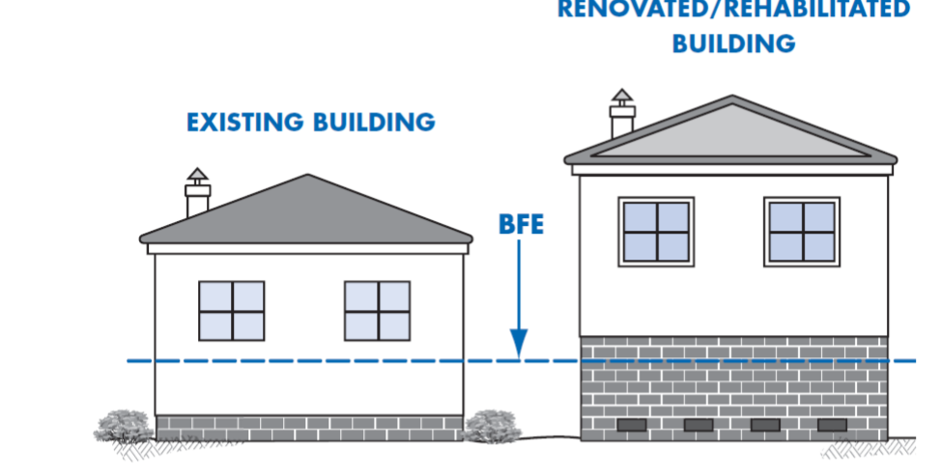
Benefit-Cost Analysis Screening
100-Yr
+2 ft
100-Year
10-Year

Slide 17
Benefit-Cost Analysis Screening RESULTS
Structures | BCR – Lower Cost | BCR – Higher Cost | BCR – High Cost and Adjustment to Lowest Floor
1837 Harpeth River Drive | 6.11 | 3.67 | 1.00
1843 Harpeth River Drive | 2.48 | 1.50 | 0.26
1845 Harpeth River Drive | 2.36 | 1.56 | 0.32
1849 Harpeth River Drive | 2.07 | 1.36 | 0.27
1901 Harpeth River Drive | 5.48 | 3.65 | 0.96
1905 Harpeth River Drive | 18.42 | 10.99 | 2.54
1908 Harpeth River Drive | 1.26 | 0.71 | 0.16
1915 Harpeth River Drive | 8.33 | 5.04 | 1.96
1919 Harpeth River Drive | 8.56 | 6.34 | 2.27
1928 Harpeth River Drive | 8.09 | 4.87 | 1.56
1940 Harpeth River Drive | 8.61 | 5.42 | 2.01
1215 Parker Place | N/A | N/A | N/A
5317 Williamsburg Road | 7.28 | 7.18 | 1.50
5309 Williamsburg Road | 8.15 | 5.37 | 1.73
Notes:
Benefit-Cost Analysis Screening
All structures are candidates for further evaluation
8 structures are strong candidates for grant application

Slide 18
HMGP Application Process
Coordination with Interested Property Owners
Notice of Voluntary Interest Form
Notice of Intent – submit to TEMA
Application Package
Phase 1 – Feasibility/Design
Phase 2 - Construction
State - TEMA Review
Federal - FEMA Review
Feasibility/Design
Survey / Elevation Cert.
Foundation Inspection
Engineering Design
Construction Cost
Termite Inspection
Finalized BCA for Phase 2
Notes:
Feasibility – also confirm correct permits are obtained; assist with bidding process for construction contractors

Slide 19
HMGP Application Process - Timeline
Coordination with Interested Property Owners------- July 2
Notice of Intent – submit to TEMA----------------------- July 9
Application Package
Prepare/Submit Phase 1------------------------------- July 30
TEMA/FEMA Review and Approval ----------- January 2022
Complete Phase 1--------------------------------- July 2022
TEMA/FEMA Review and Approval ----------- January 2023
Phase 2 – Construction ------------------------------ Beginning 2023

Slide 20
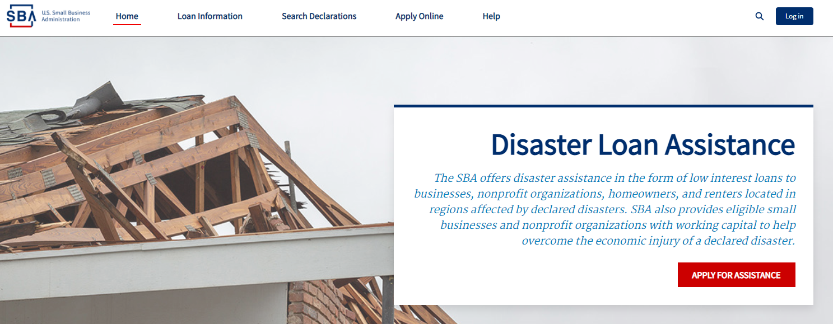
OPTION: SBA LOAN
Small Business Administration
$200,000 for repair/elevation of structure
$40,000 for contents
Interest rate will not exceed 4%
https://disasterloanassistance.sba.gov/ela/s/

Slide 21
Communicating With You
Handouts
Homeowners Guide to HMGP
Elevation Projects Information Sheet
Forms
Let City know if you are interested in moving forward
Complete the Voluntary Participation Form
Regular Status Updates
With email addresses, City will keep homeowners up to date on status of application and implementation
Questions for City Staff - Todd Petrowski
Email - todd.petrowski@brentwoodtn.gov
Phone - 615-371-2232

Slide 22
Final Questions?

